Slide 1
Overview WG4 Gravitational waves and cosmology
Simone Mastrogiovanni, INFN Rome
and
Carlo Tasillo, DESY Hamburg
Workshop of the JENAS Initiative “Gravitational Wave Probes of Fundamental Physics”
February 9th, 2024
Sapienza University of Rome

Slide 2
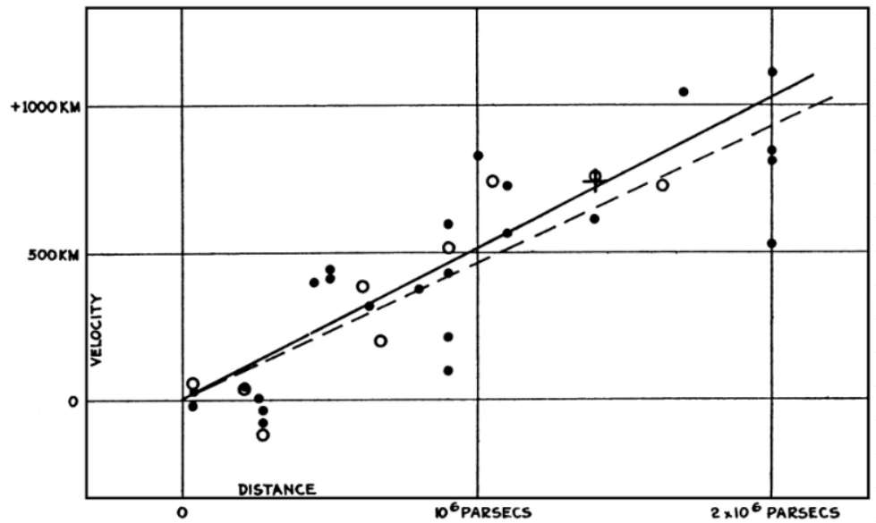
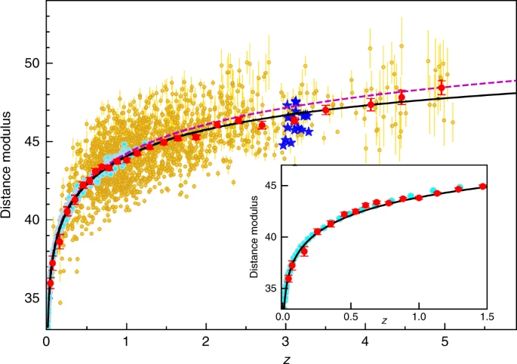
The standard cosmological model?
For almost 100 years, we have been measuring the expansion of the Universe
Velocity [km/s]
[E. Hubble 1929]
[G. Risalti et al, Nature 2023]
Distance [Mpc]

Slide 3
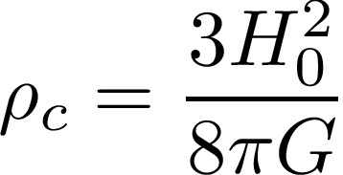
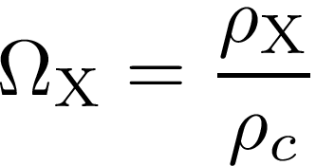
The standard cosmological model?
According to General Relativity, and confirmed by many observations, the Universe is expanding with a rate described by
Critical density
Hubble constant
Dark matter
Dark energy
Radiation
Curvature
The cosmic expansion offers us many potential discoveries:
What are the energy species living in our Universe?
Is General Relativity valid on cosmological scales?
What are the average and critical densities of the Universe?
Energy density

Slide 4
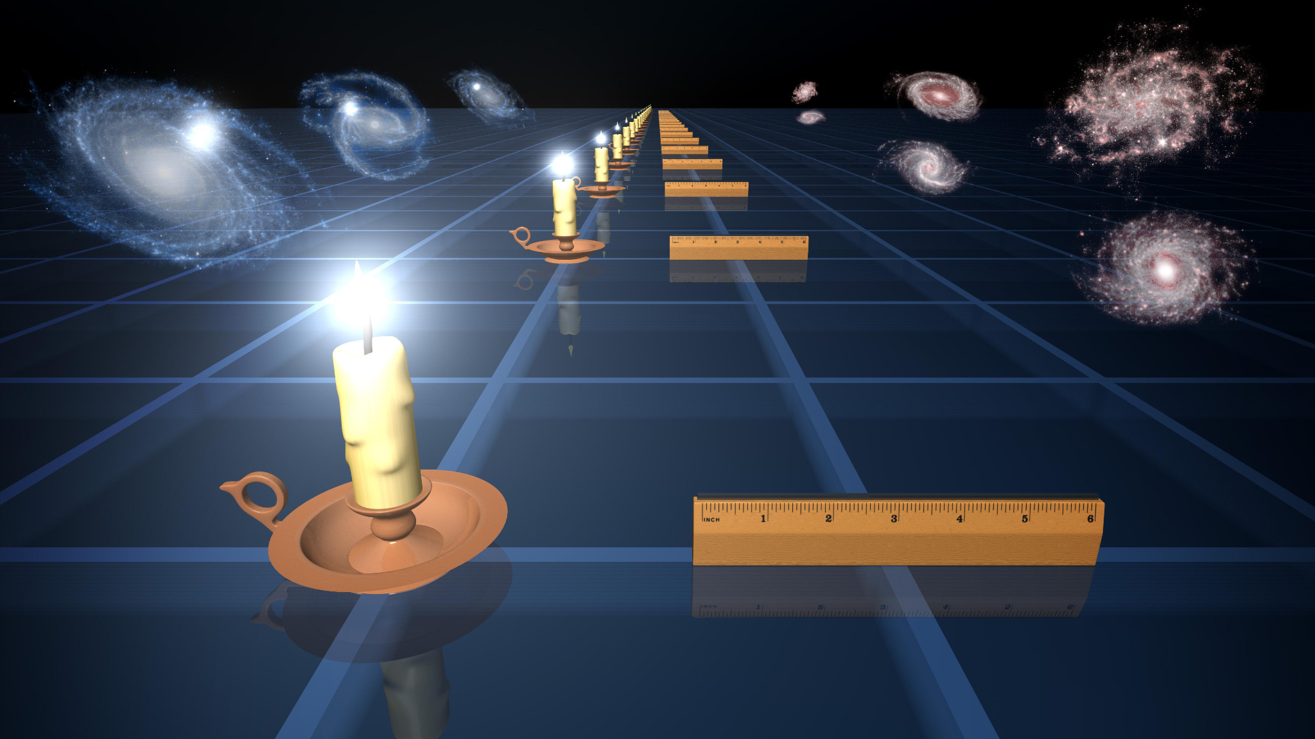
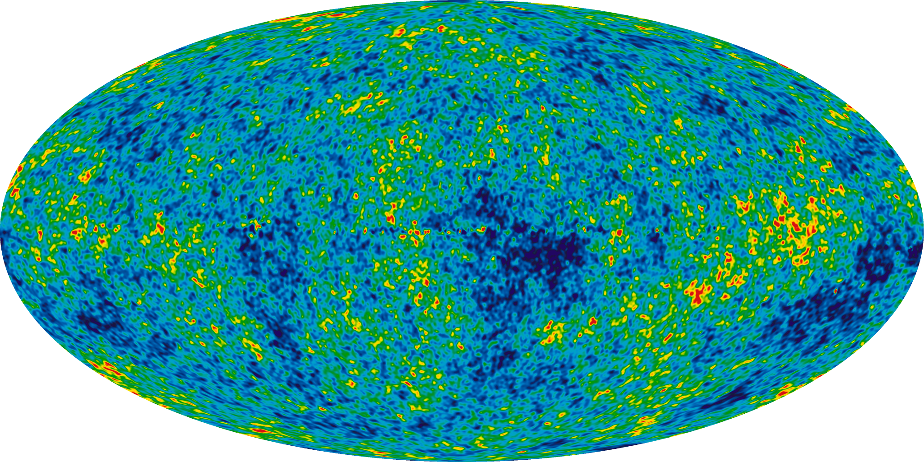
How have been measuring the Universe expansion so far?
Direct (Standard Candles)
Indirect
Cepheids, Supernovae Type IA, Active Galactic nuclei ,Kilonovae (?) and short Gamma-ray Burst
Issues: Requires complex astrophysical calibration
Cosmic Microwave Background temperature fluctuations, Baryonic nucleosynthesis
Issues: Cosmic variance (a single Universe)

Slide 5
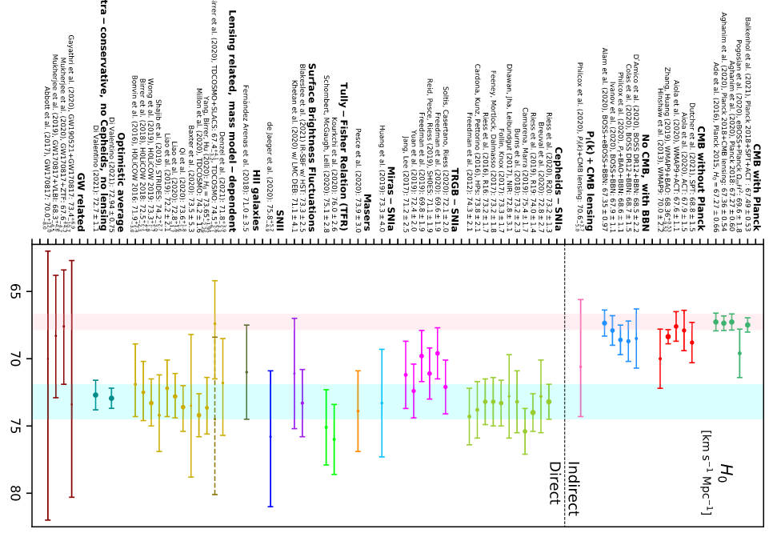
Measurements of the Hubble constant
There is a tension between direct and indirect measurements of the Hubble constant.
Although in-depth studies for hidden systematics the tension has not been yet alleviated.
We require to directly measure the Universe expansion in all the observable Universe.
[Di Valentino, E. CQG 38 (2021)]

Slide 6
Gravitational Wave sources at cosmological scales
From GWs we can not measure the source redshift (escaping velocity)
In recent years, we used several methods to assign a redshift to GW sources
Bright sirens: An associated Electromagnetic (EM) counterpart (GRB, Kilonova etc…) can provide the identification of the host galaxy.
Dark sirens: Galaxy surveys can be used to identify possible hosts in the GW localization volume.
Spectral sirens: Knowledge of the source-frame mass distribution can be used to assign a redshift to GW sources.

Slide 7
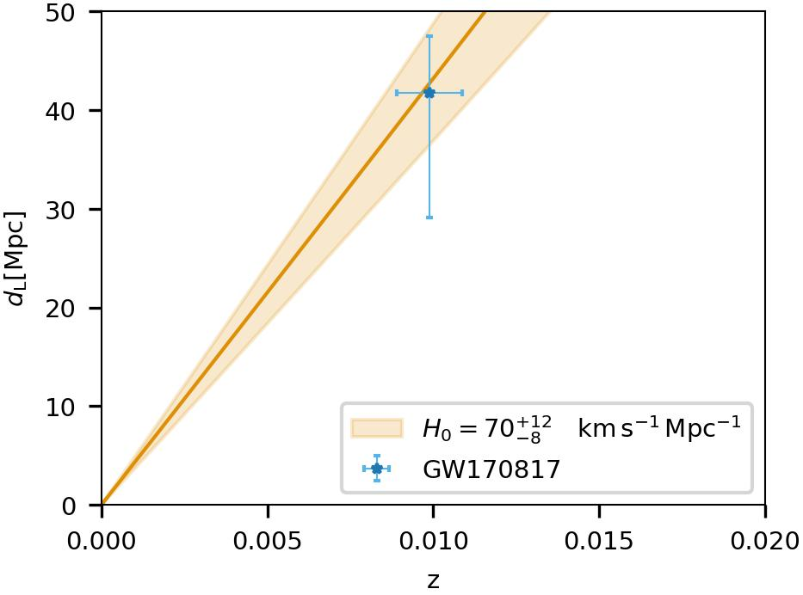
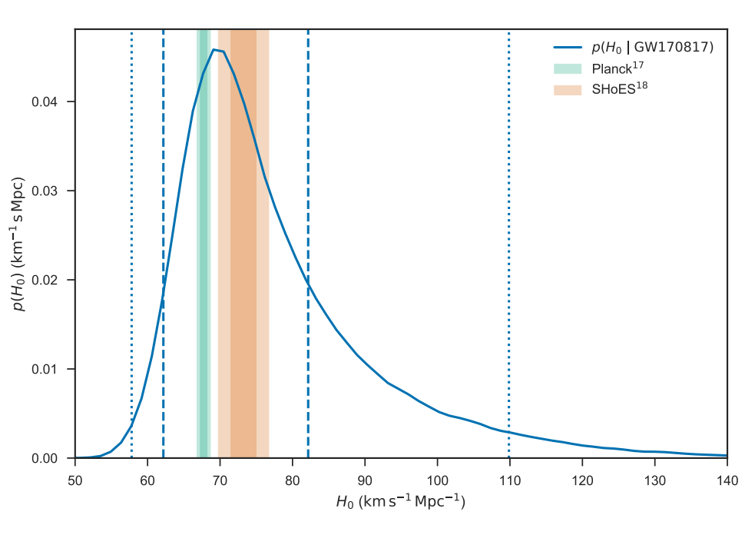
Bright sirens: Cosmology with GW170817
[LVC+, Nature (2017)]

Slide 8
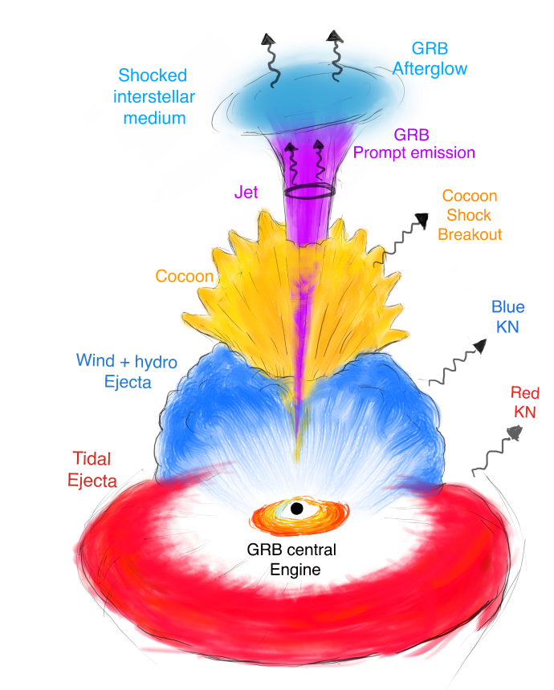
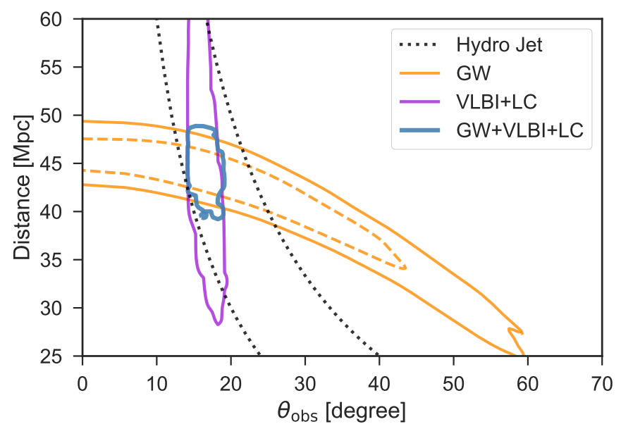
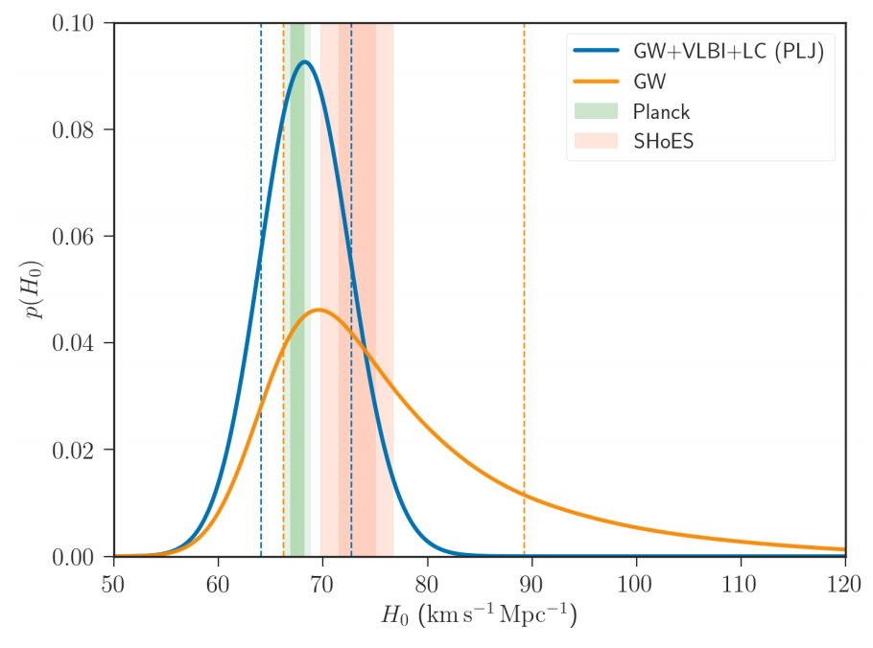
Bright sirens: Cosmology with GW170817
Afterglow informed cosmology
[K. Hotokezaka, Nature Astronomy, 3(2019)]
Open question: Can we standardize the GRB and KN emissions from BNS mergers?

Slide 9
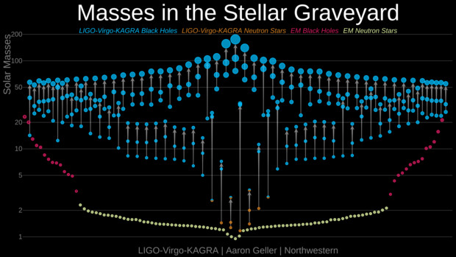
Dark Sirens cosmology
GW Black Holes
“Electromagnetic”
Black Holes
GW Neutron Stars
Neutron Stars (pulsars)

Slide 10
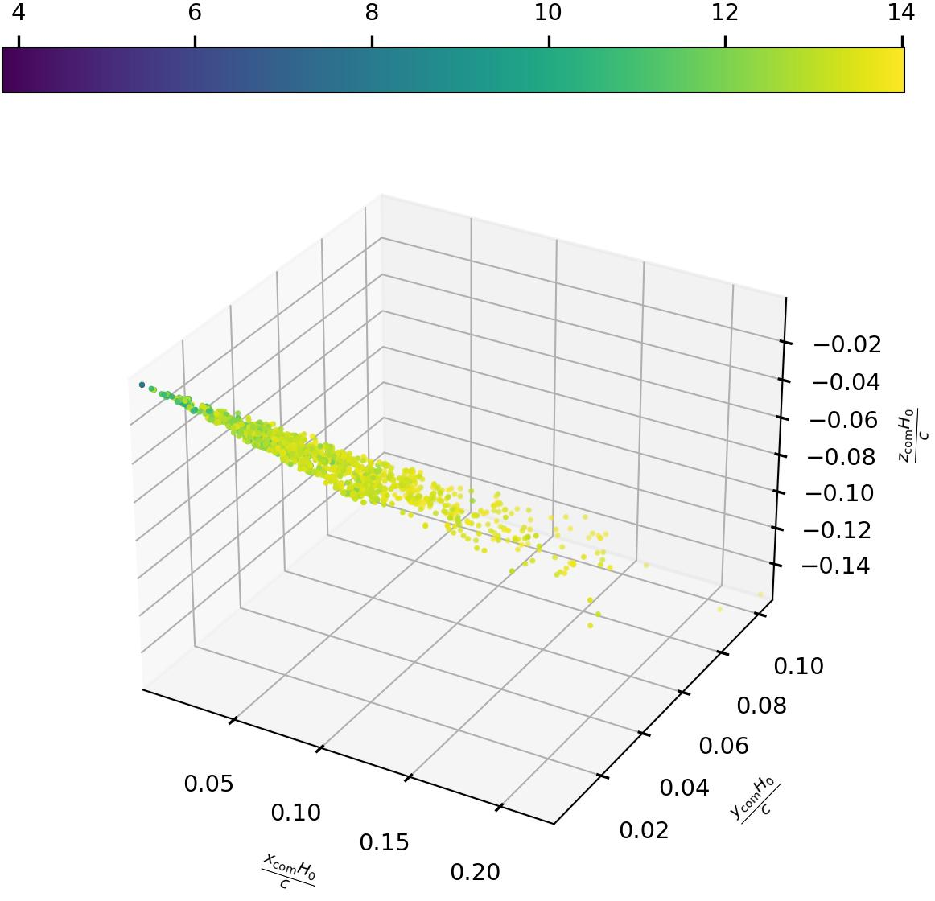
Dark sirens: Cosmology aided by galaxy surveys
Apparent magnitude
A cosmological model has statistical support when the GW localization matched an overdensity of galaxies.
Galaxy catalogs are not complete at higher redshifts, we need to apply corrections in order to now bias our analyses [R. Gray+, PRD (2019)].
Open question: How does galaxy properties correlate with CBC hosting?
Two main actors: Star Formation rate and total stellar mass [M. Artale +, MNRAS (2021)]
GW190814 H₀=67.7 km/s/Mpc
GW190814 H₀=120 km/s/Mpc
Fainter galaxies

Slide 11
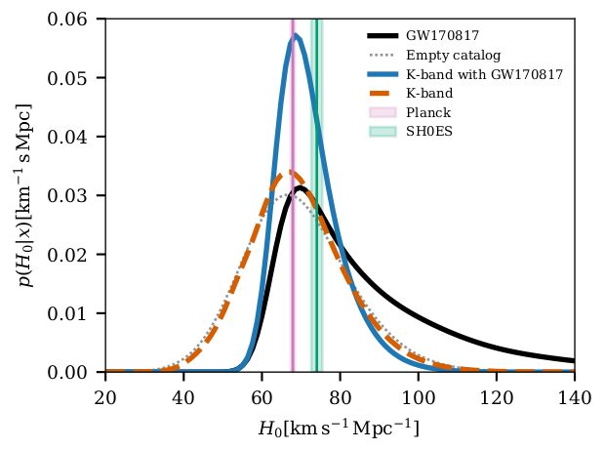
GW cosmology after GWTC-3: Dark sirens
[LVK+, ApJ 949 76 (2023)]
H₀ = 68 +8 -6 km/s/Mpc
Main result of the paper showing various H0 posteriors.
We select the K-band for the luminosities of galaxies and the preferred mass model (powerlaw+Gaussian peak)
H₀ = 67 +13 -12 km/s/Mpc
H₀ = 67 +14 -13 km/s/Mpc
H₀ = 70 +12 -8 km/s/Mpc

Slide 12
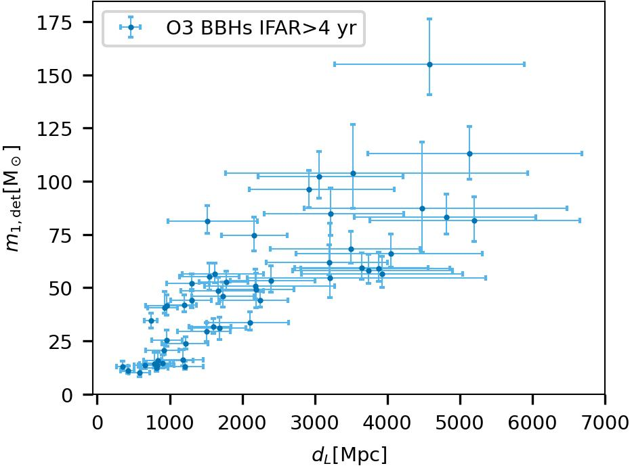
Spectral sirens: GW-only cosmology
Many GW are detected with large sky localizations and are very far (galaxy catalogs highly incomplete).
If BBHs are preferentially produced at a given mass, we can exploit the mass-redshift relation to assign a redshift to the GW source [SM+, PRD 104 (2021)].
Excess of BBHs

Slide 13
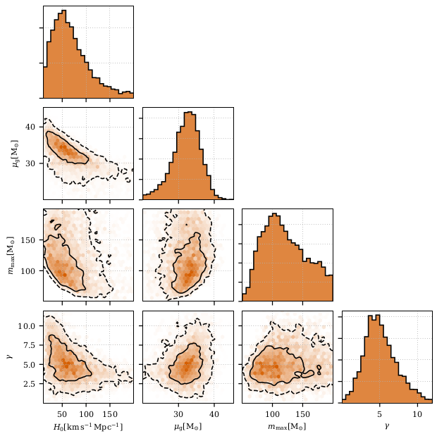
GW cosmology after GWTC-3: Spectral sirens
Statistical result with GW data only,
no galaxy catalog information has been used
The excess of BBHs around 35 solar
masses sets a scale for the redshift
and provides constraints on H0.
[LVK+, ApJ 949 76 (2023)]
Population parameters that correlate with H0
Posteriors of H₀, mu of the Gaussian peak, maximum mass of the BH and the merger rate evolution.

Slide 14
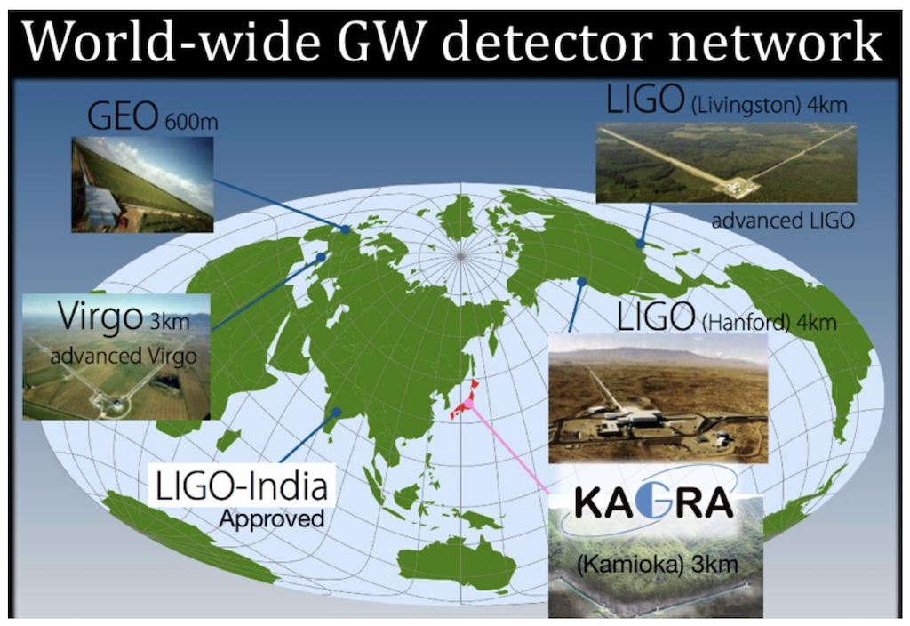
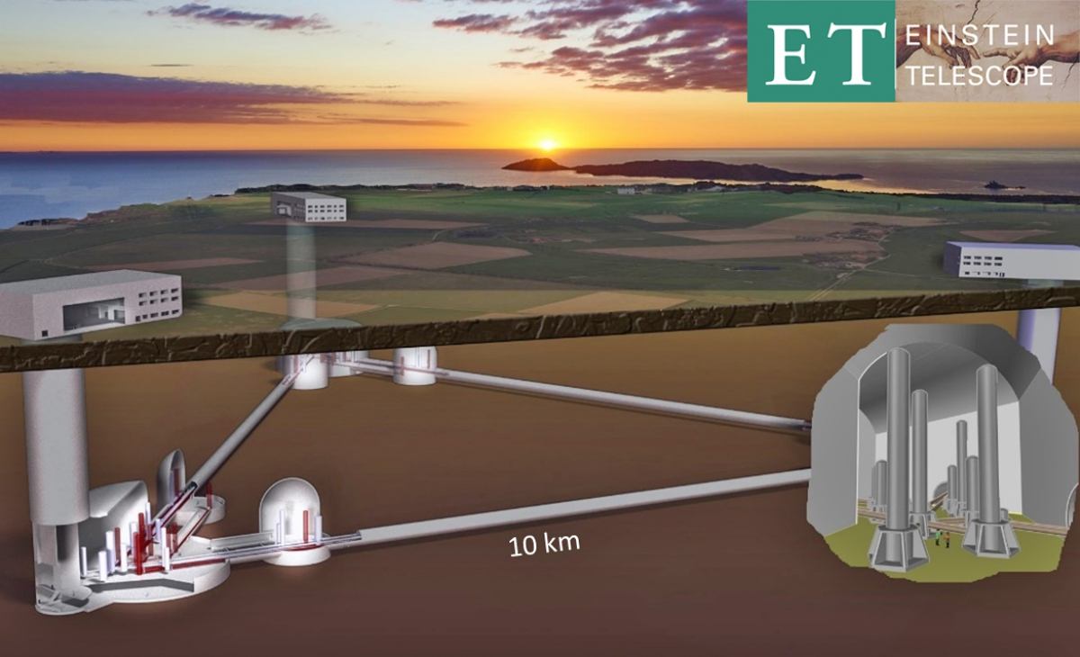
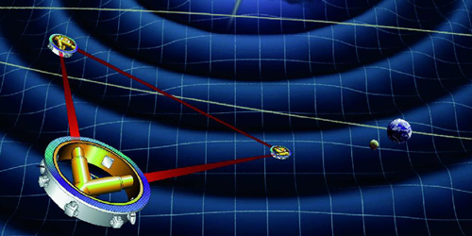
What is next for GW cosmology?
Improving the current detector network < 2035
Einstein Telescope 2035+
LISA 2035+

Slide 15
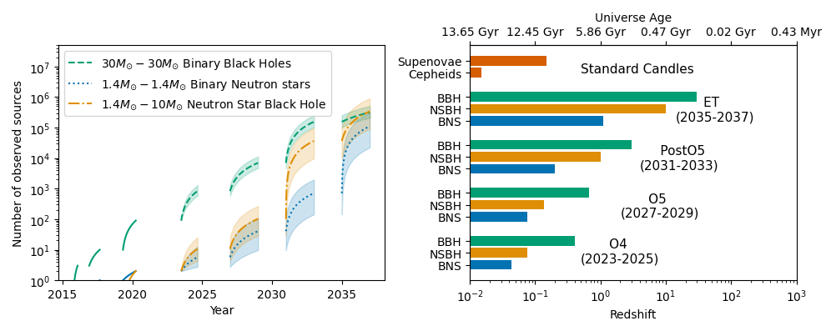
Moving forward with ground-based GW detectors
HERA SKAO
EUCLID
O5
O4
O3
ET
O2
O1
PostO5
Using expected detection ranges from

Slide 16
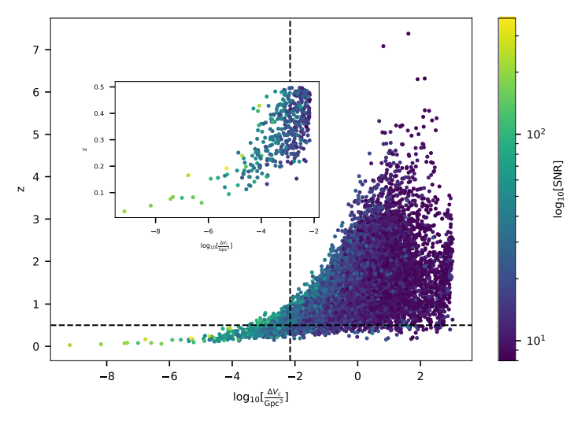
Dark sirens with 2.5 Generation GW detectors
Localization is of crucial importance for the galaxy catalog method.
About 3000 dark sirens will be localized better than GW190814.
~5 dark sirens will be so well localized to have ~1 galaxy in their localization volume.
~100 dark sirens will have less than 1000 galaxies in their localization paper.
With one year of observation, constraint on H0 at the 5% precision
https://arxiv.org/pdf/2402.03120.pdf

Slide 17
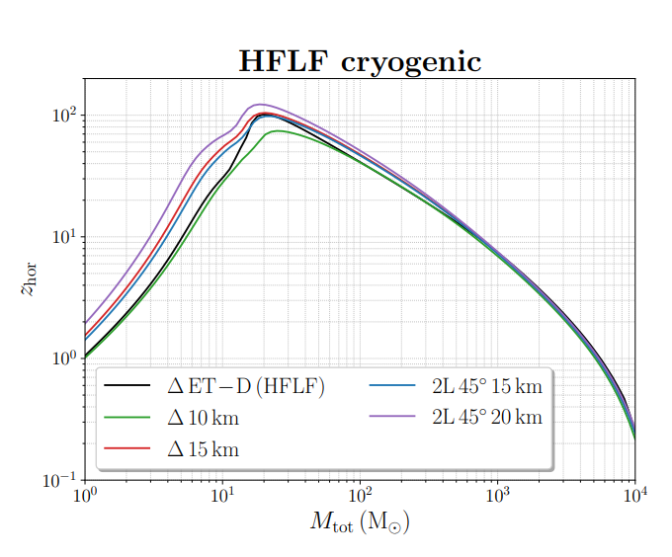
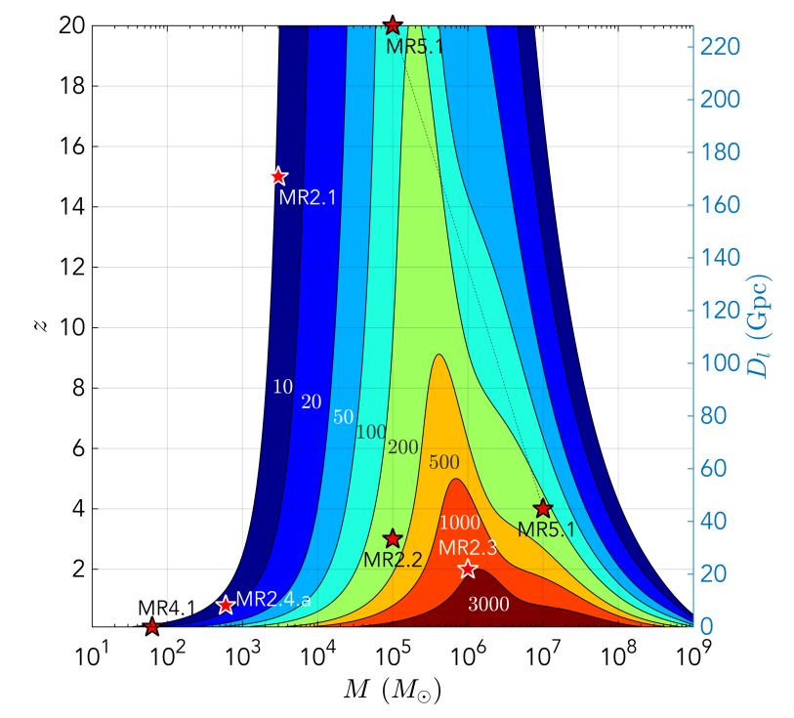
Detection ranges of 3G detectors
Detection prospects for LISA
Detection prospects for Einstein Telescope
M. Branchesi, JCAP07(2023)068
P. Amaro-Seoane arXiv 1702.00786
13
10

Slide 18
Gravitational wave backgrounds

Slide 19
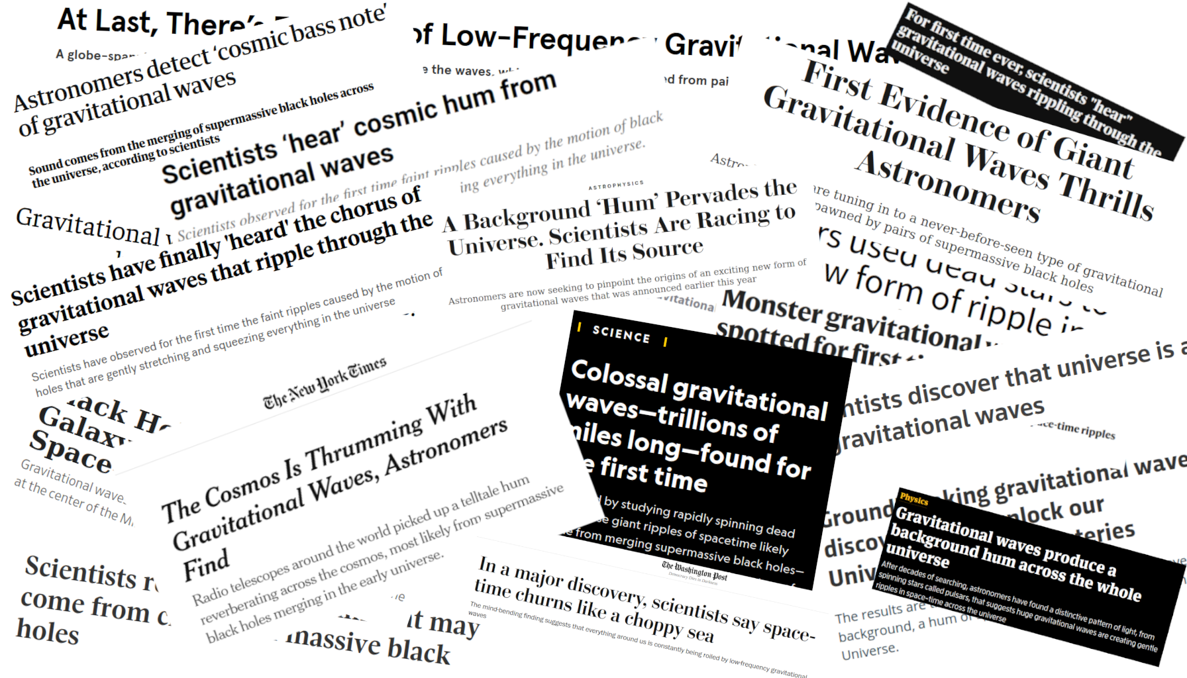
In case you haven’t heard the news
13
10

Slide 20
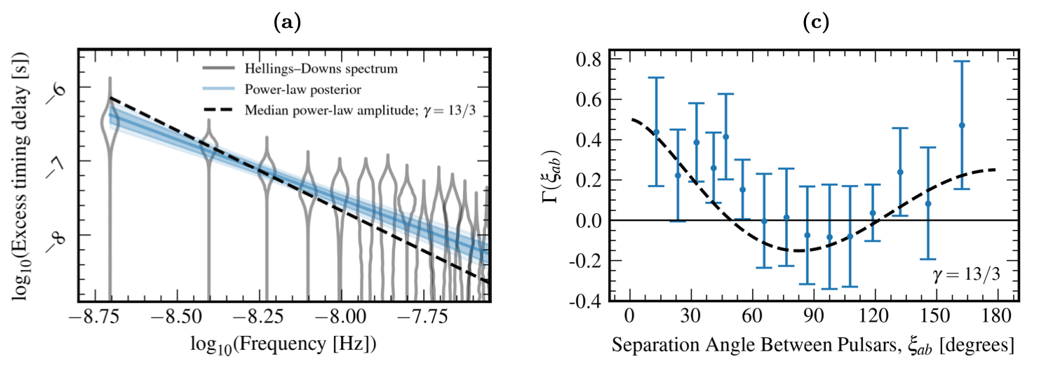
In case you haven’t heard the news…
[NANOGrav, Astrophys.J.Lett. 951 (2023)]
Several pulsar timing arrays found a gravitational wave background at O(10 nHz) in June 2023!
See: Sarah’s talk earlier today
13
10

Slide 21
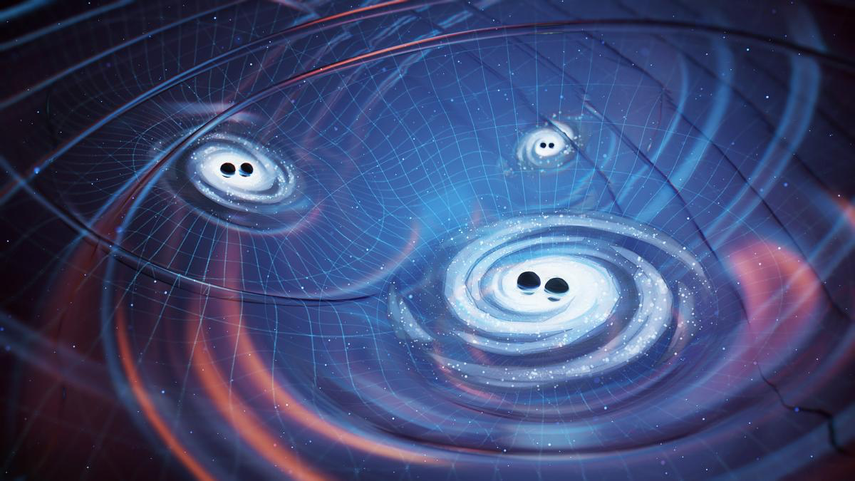
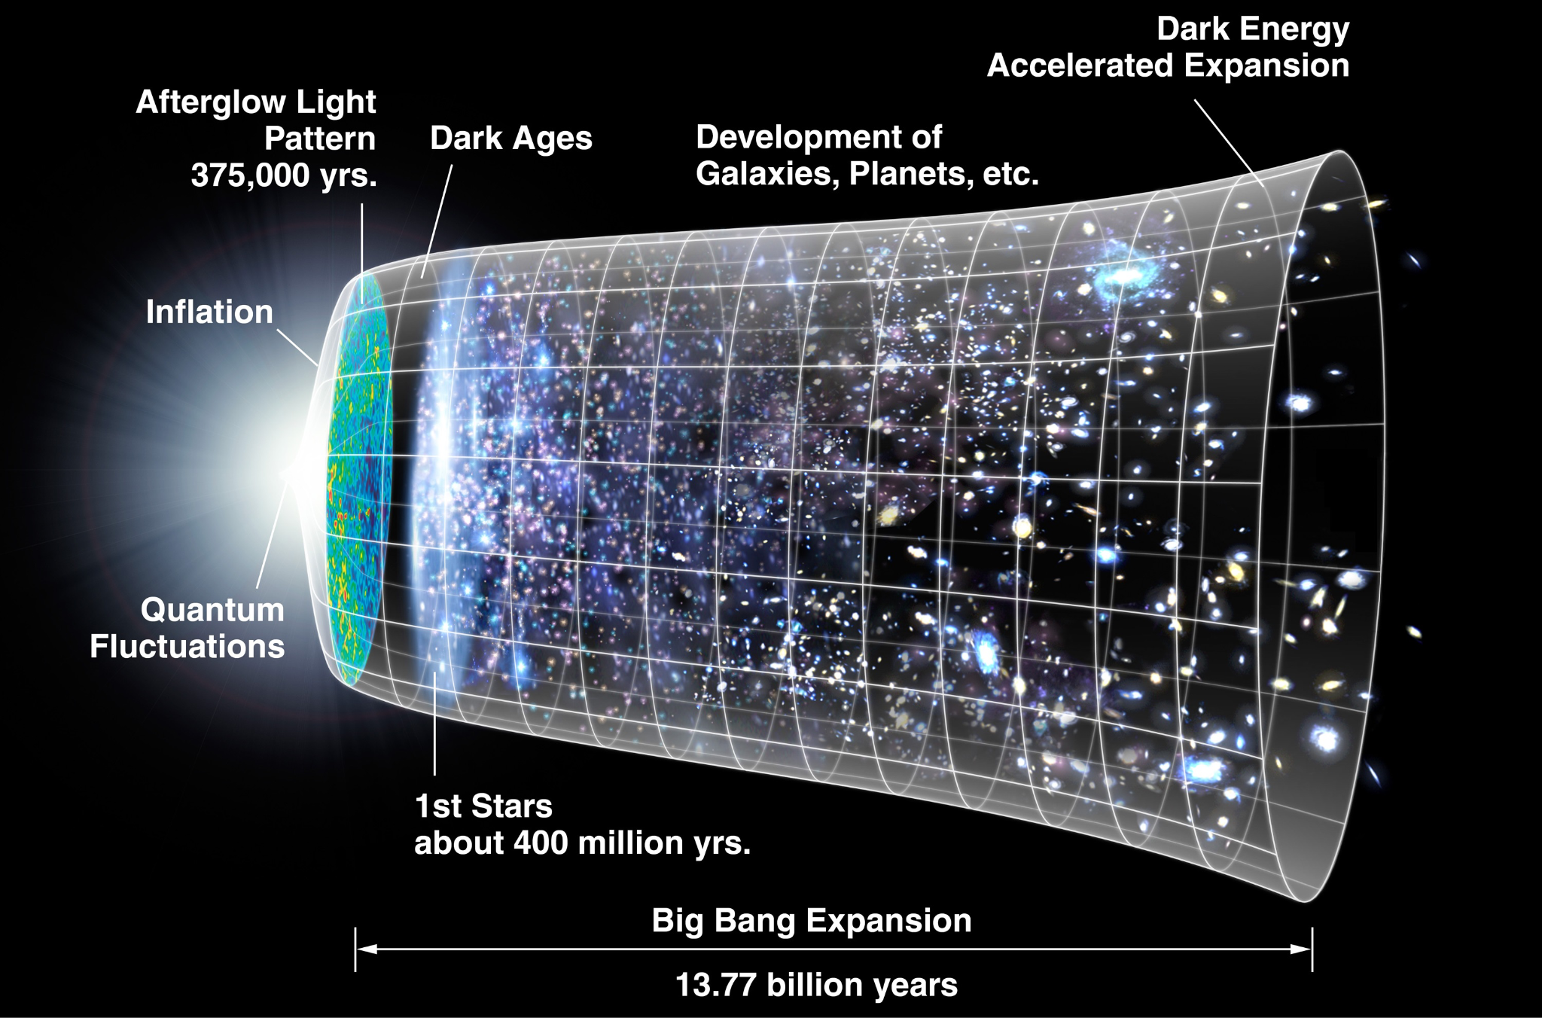
What sourced the pulsar timing signal?
Supermassive black hole binaries?
The Big Bang?
Image credit: NANOGrav collaboration
Image credit: NASA
Individual SMBH mergers have not been observed so far. The precise spectral shape of the GW signal is unknown, but its existence is a robust prediction.
Many speculative signal sources and predictions exist. See: talks by Antonino & CT
13
10

Slide 22
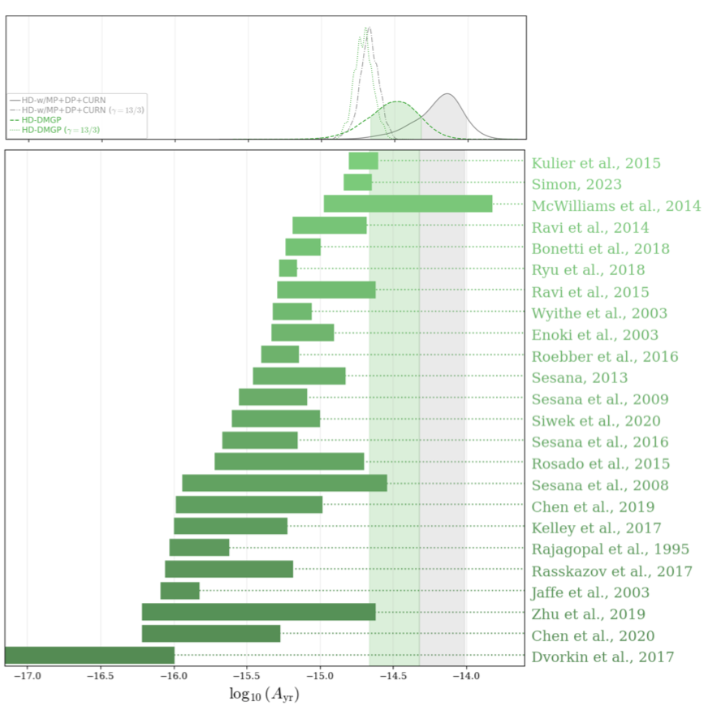
What sourced the pulsar timing signal?
Observed GW amplitude
d = O(pc)
Predictions
Final parsec problem
Need additional feedback (scattering of individual stars, third SMBH, …) to extract energy and “harden” the binary to make them inspiral sufficiently quickly.
Data requires shorter hardening timescales, higher SMBH number densities and masses than previously expected.
[NANOGrav, Astrophys.J.Lett. 952 (2023)]
13
10

Slide 23
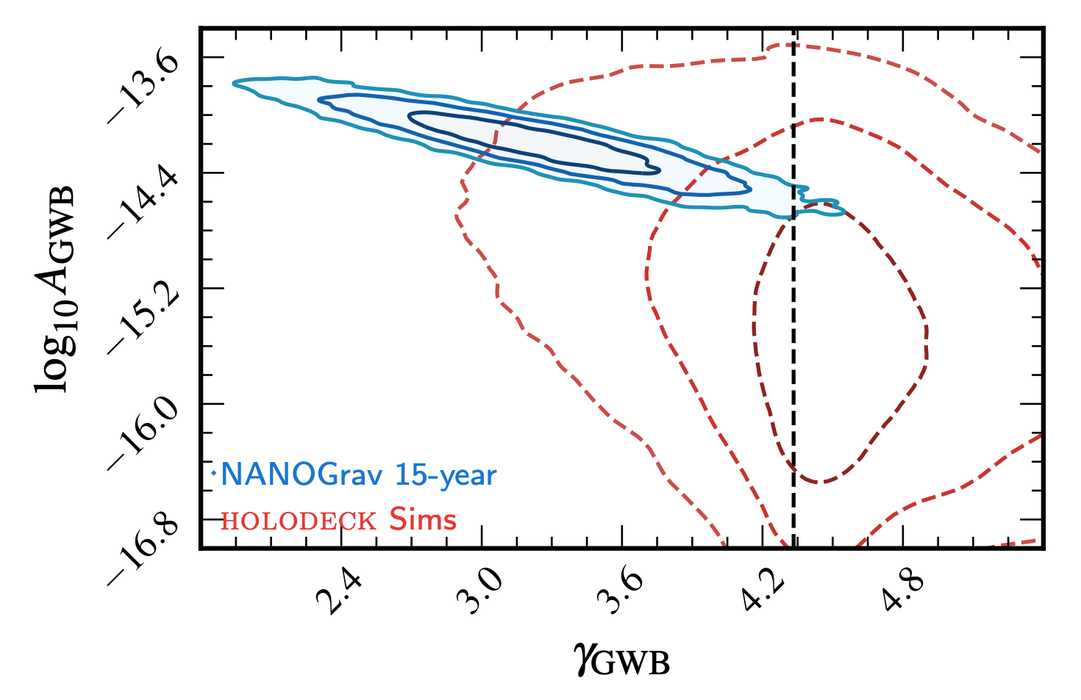
What sourced the pulsar timing signal?
The observed signal is consistent with a power-law of amplitude A and slope 𝛄.
Simulations assuming realistic SMBH populations yield too-low GW amplitudes and favor steeper slopes.
The tension might also be ameliorated if additional sources contribute…
[NANOGrav, Astrophys.J.Lett. 951 (2023)]
13
10

Slide 24
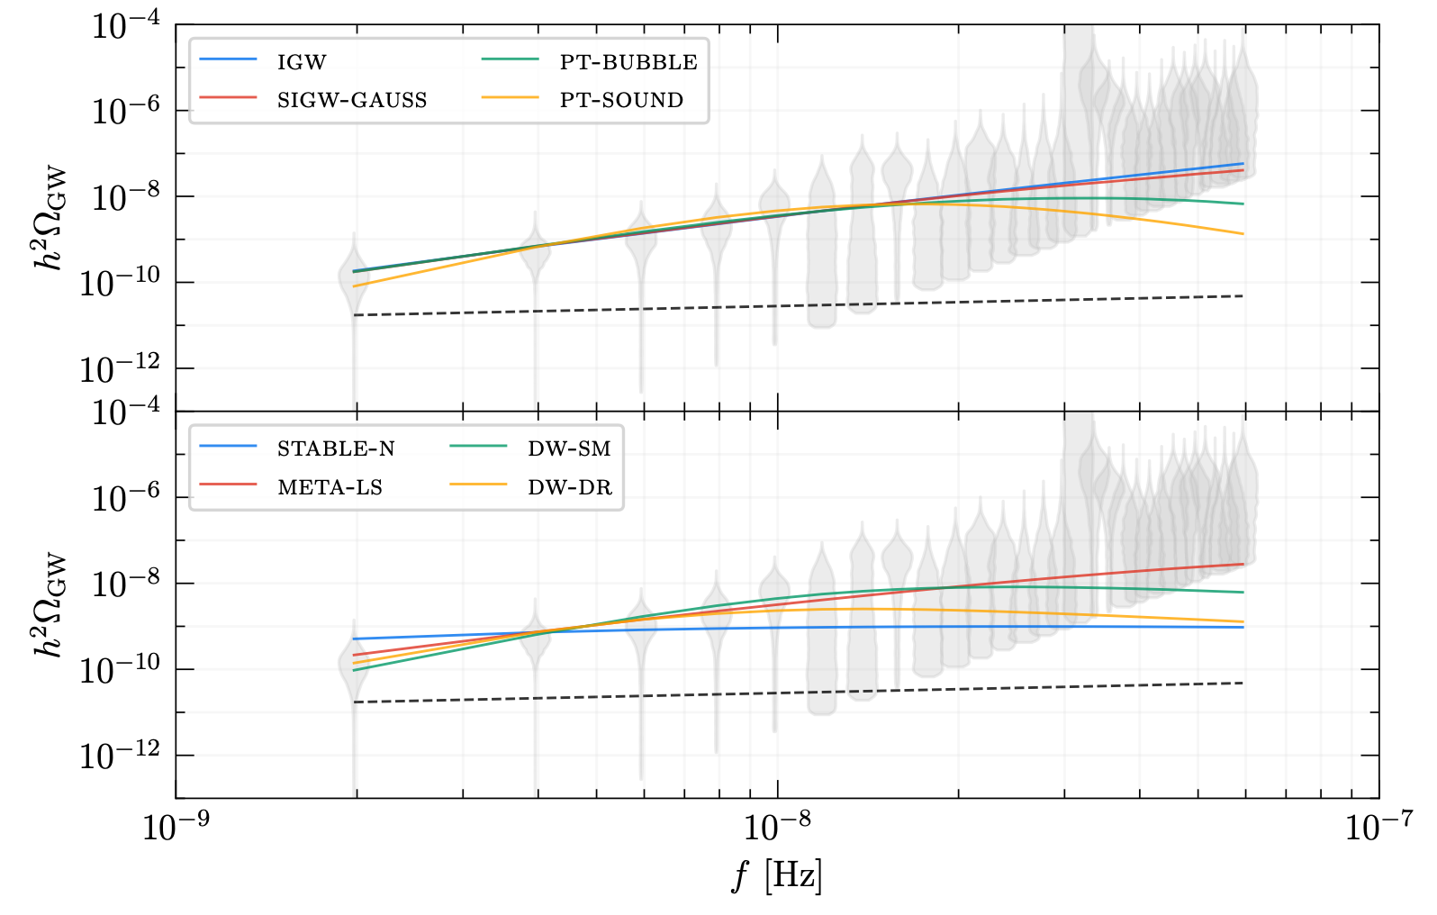
Cosmological sources of nHz gravitational waves
Inflationary GWs
Phase Transitions
Scalar-induced GWs
Domain Walls
[NANOGrav, Astrophys.J.Lett. 951 (2023), L11]
Cosmic strings
Audible axions
Supermassive PBHs
[see following talks]
Supermassive black hole binaries
13
10

Slide 25
Quo vadis pulsar timing?
We are here!
❌
Anisotropies?
✅
Continuous wave signals?
❌
✅
Incl. multi-messenger detection?
Possibly:
If the signal is indeed from SMBHBs, we will soon find anisotropies and individual events. Else: look out for signals from the early cosmos!
[Thanks to A. Mitridate for the flowchart idea!]

Slide 26
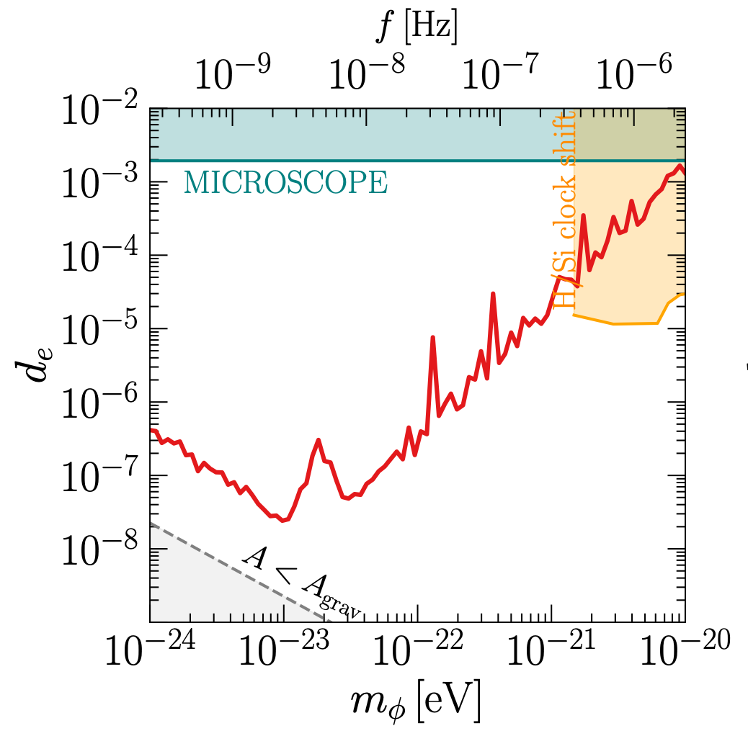
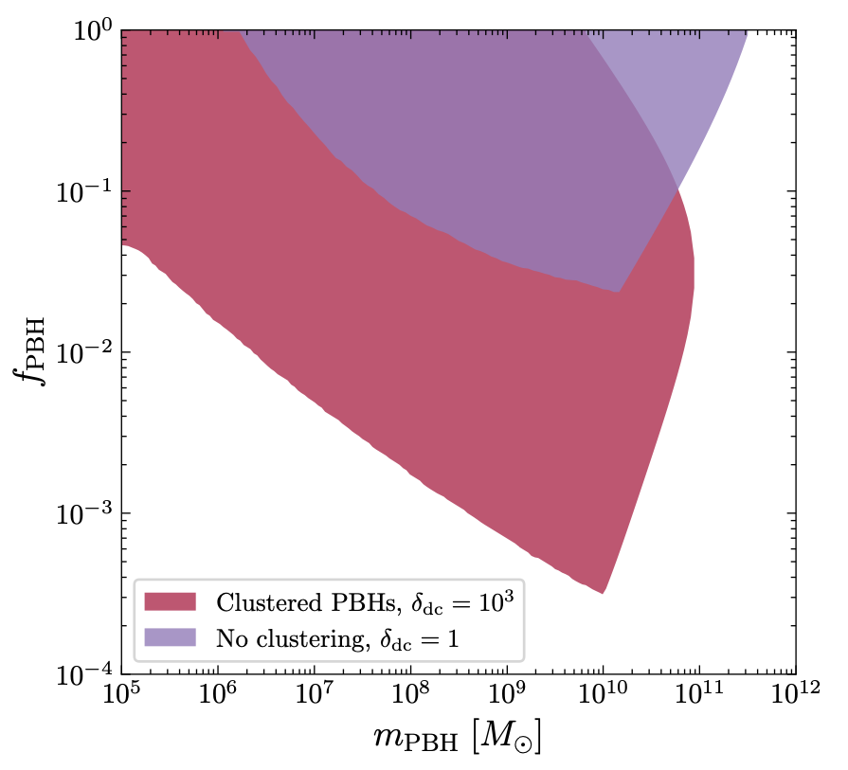
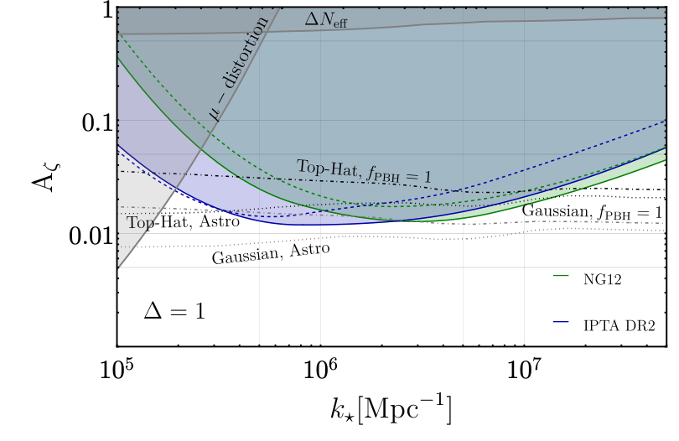
Novel bounds on new physics models from PTAs
Ultralight dark matter
(Clustered) supermassive, primordial black holes
Even if SMBH mergers are indeed responsible for the nHz signal, we can still use it to put bounds on new physics!
Primordial scalar power-spectrum
[NANOGrav, Astrophys.J.Lett. 951 (2023) 1, L11]
[CT+, 2306.17836]
13
[Dandoy+, SciPost Phys.Core 6 (2023) 060]
10

Slide 27
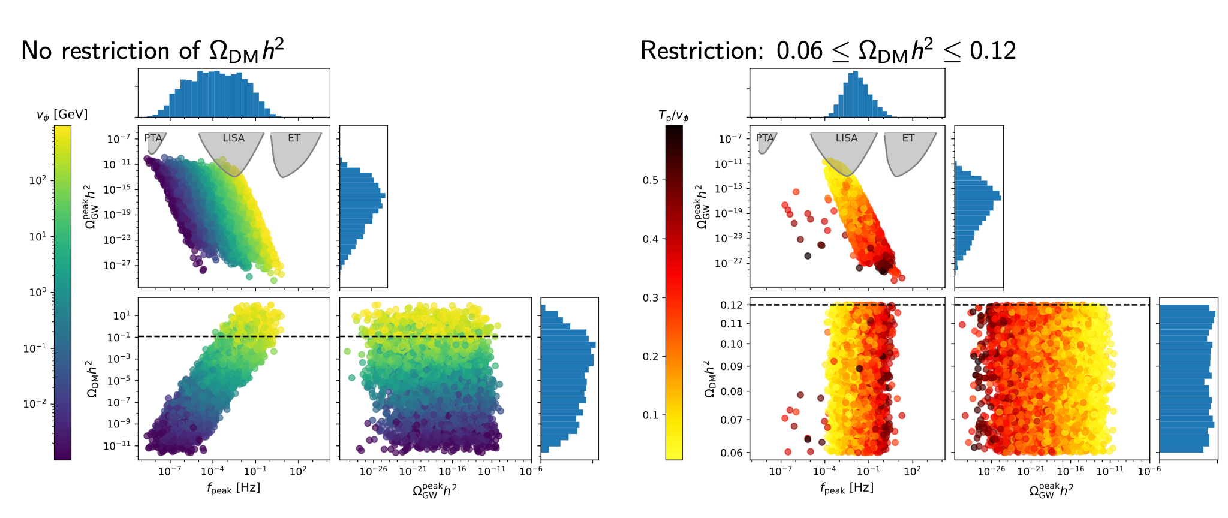
The next frontier: LISA and ET
If LISA finds a mHz background, it might be due to a dark sector phase transition giving rise to dark matter!
A new WIMP miracle?
[CT+, 2311.06346]

Slide 28
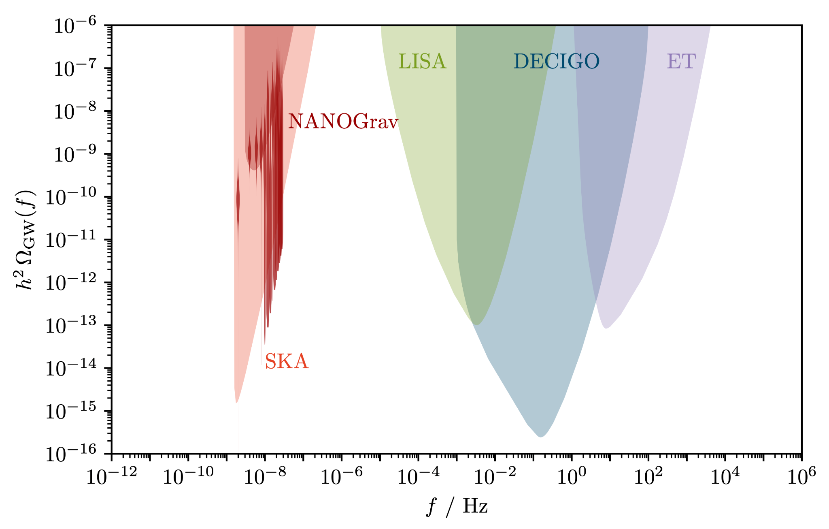
The need for new GW observatories
CMB bound on cosmological GW backgrounds
How does the PTA signal evolve at 𝜇Hz?
→ 𝜇Ares, astrometry?
Phase transitions in the very early universe? Merging PBHs with tiny masses?
→ Reuse of axion experiments?
GWs from inflation?
→ Pixie?
10
13

Slide 29
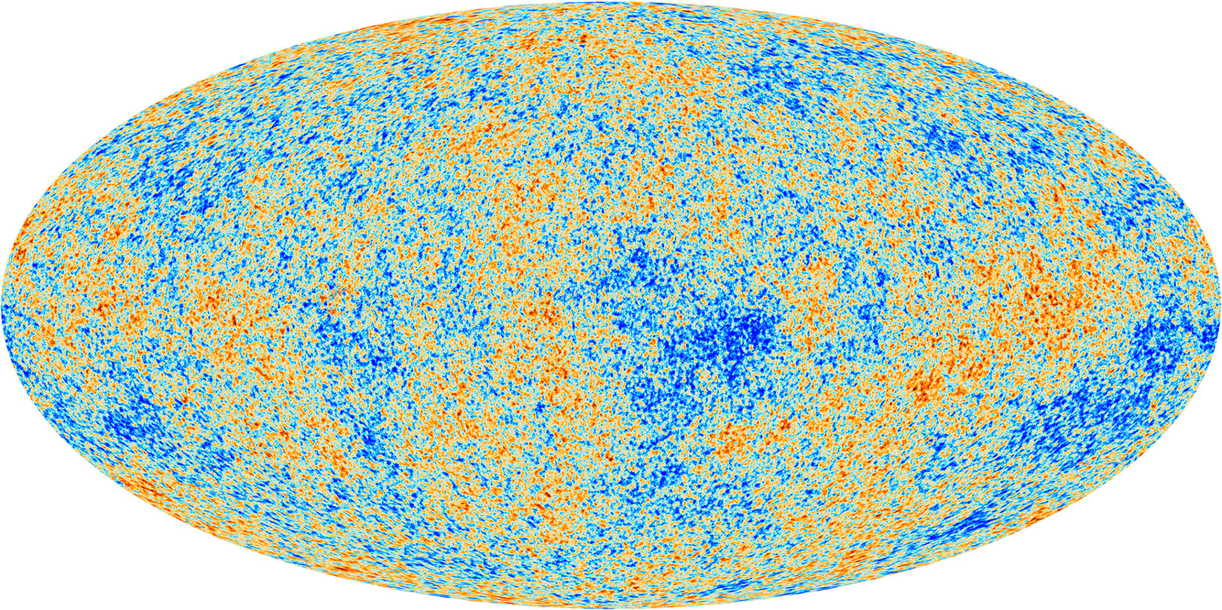
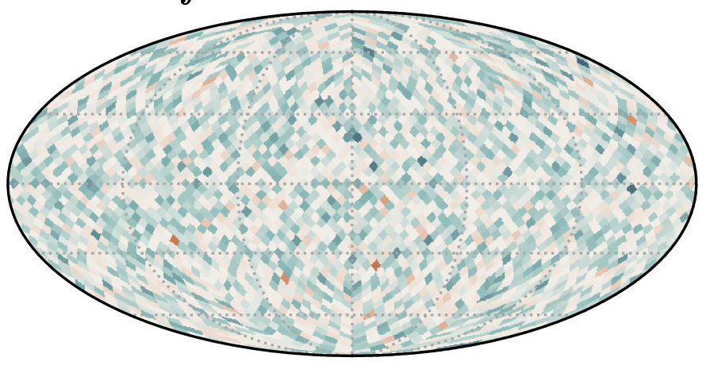
The future of gravitational wave backgrounds
The holy grail of cosmology in the 20th century: The CMB.
Will the GW background be the main observation of the 21st century in cosmology?
[Planck collaboration]
[Sato-Polito, Kamionkowski: 2305.05690]

Slide 30
Summary
We are at the dawn of GW cosmology
…
PTAs will understanding SMBHBs (final parsec-problem, rate of galaxy mergers, mass distribution, …)
Look out for anisotropies and individual inspirals at nHz
Novel constraints on BSM physics
We need new ideas for GW detection <nHz, @𝜇Hz, >MHz

